Slide 1
HCDR3 Loop Modeling
Jessica Finn
Rosetta Workshop
April 25th, 2017

Slide 2
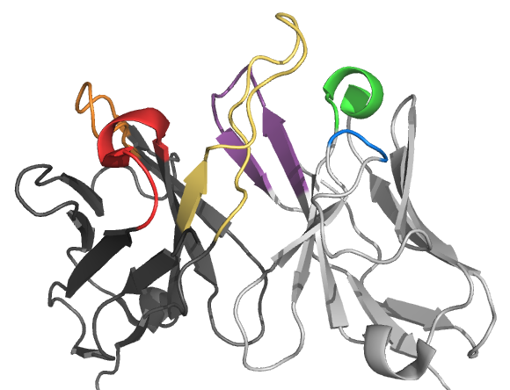
Antibodies recognize and bind targets using six complementarity determining region loops
HCDR3
HCDR2
LCDR3
LCDR1
HCDR1
LCDR2
Notes:
Before we begin discussing the protocol, I’d like to get everyone acquainted with what the HCDR3 loop is, and why modeling this loop presents special difficulty.

Slide 3
CDR loops have been extensively studied and characterized
For 5 of 6 CDR loops, there are robust rules that define canonical structures
The HCDR3 loop is extremely variable and only canonical domains can be identified
Notes:
We’ve also extensively characterized the structures of these CDR loops. These two papers discovered that five of the six HCDR3 loops fall into canonical classes, meaning there are few structural motifs available for each loop.
Only the HCDR3 loop escapes such classification.

Slide 4
Many modeling techniques cannot predict HCDR3 loops
Jordan Willis

Slide 5
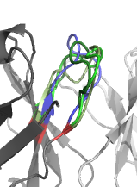
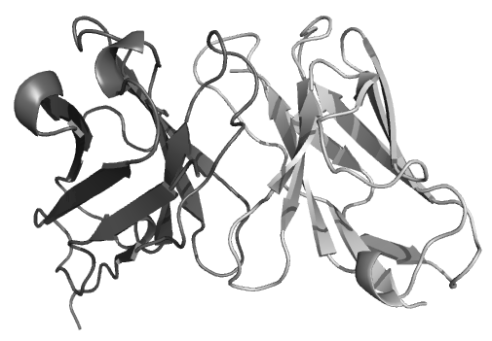
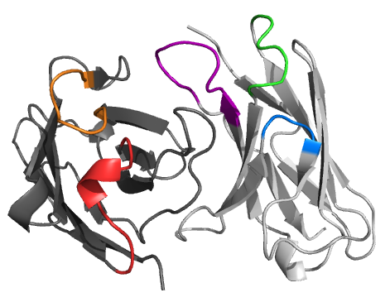
How can we use Rosetta to model antibodies?
Identify homologous
framework regions
Graft canonical
CDR loops
De novo
model HCDR3

Slide 6
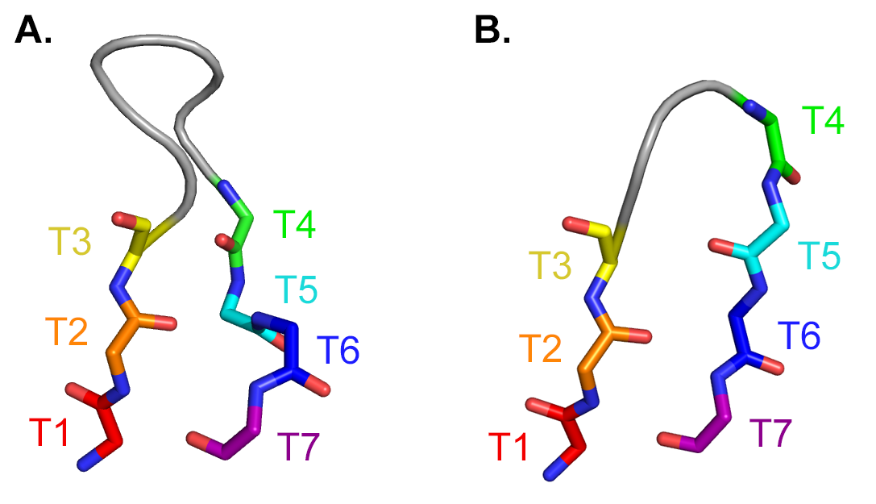
De novo loop modeling in Rosetta
2° Structure Prediction, PDB Fragments, Energy Function, Restraints
D
Y
ARDYLD
AYYMDV
de novo modeling
M
R
D
A
V
Primary Sequence
Tertiary Structure

Slide 7
De novo loop modeling in Rosetta
Stage 1: Remodel (Cyclic Coordinate Descent (CCD))
Fast broad sampling of backbone conformations (centroid)
Stage 2: Refine (Kinematic Loop Closure Method (KIC))
All-atom side chains, evaluated with Rosetta’s high-resolution scoring function.
Canutescu, A. A., & Dunbrack, R. L. (2003). Protein Science, 12(5), 963‐972.

Slide 8
Necessary input files for the de novo loop modeling protocol
FASTA file of your antibody sequence
Secondary structure prediction files
Fragment library files
Options file
(Optional) Constraints file

Slide 9
Fragment library generation

Slide 10
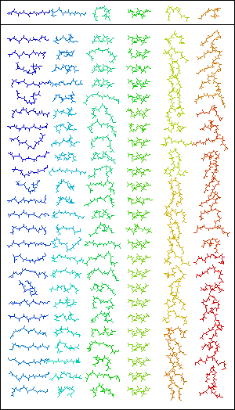
What are fragments?
3 and 9 amino acid peptides generated from the PDB
Fragments change the geometry of the protein
Scoring functions identify and maintain good fragments

Slide 11
Fragment file generation
Setup | Vall database Primary sequence Secondary structure prediction NMR data (if applicable)
Pick Candidates | Gather all possible fragments Score candidates based on input
Select Fragments | Keep the best N fragments Default = 200 per sequence Write to fragment files

Slide 12
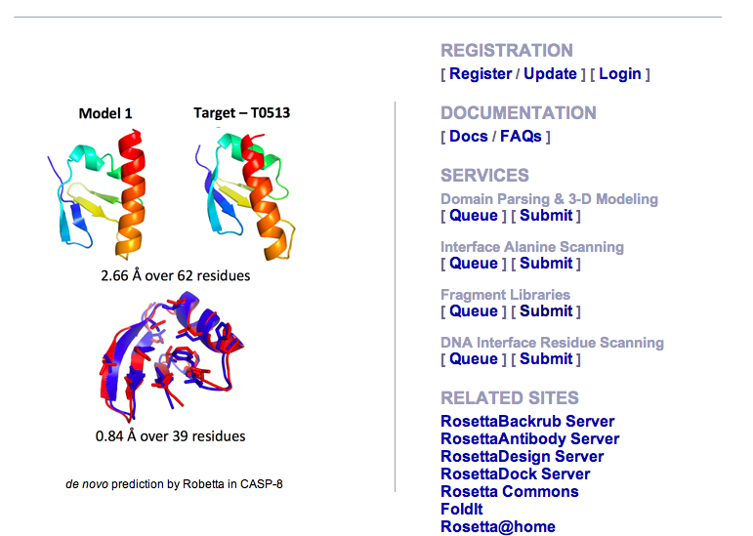
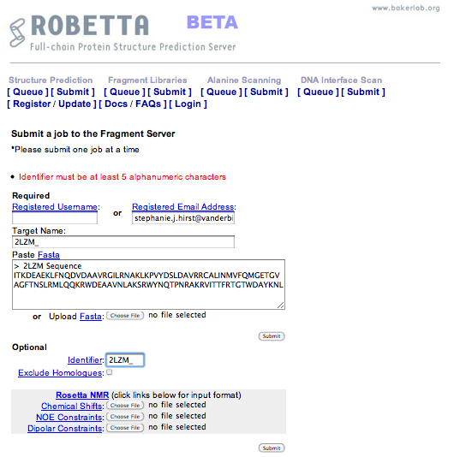
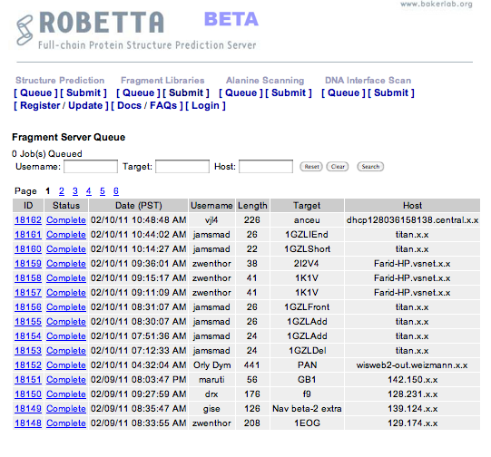
Making fragments with Robetta
http://robetta.bakerlab.org/
Notes:
The method outlined in the text of the tutorial uses the Robetta server.
This public webserver requires registration.
Once you’re logged in, select Submit under Fragment Libraries.
Input your protein sequence. Click Submit. Your job is added to the queue.
Robetta may take some time because it’s a public server; especially today, if all of us attempt to submit jobs at the same time!
For this tutorial, the fragment files have been provided for you. You do NOT need to run Robetta. (REPEAT)

Slide 13
Making fragments with the Fragment Picker
Using the fragment picker provides more control over fragment generation
The fragment picker is an application within Rosetta, and is run from the command line
Output files from Robetta can be used as preparation files for the fragment picker

Slide 14
Rosetta options file

Slide 15
Loop building options
-s 4m5y_renum.pdb #Starting pdb with loops to rebuild
-loops:loop_file 4m5y_.loops #Loop file, defining which loop to rebuild
-loops:extended true #Force phi-psi angles to be set to 180 degrees
-loops:idealize_after_loop_close #Give idealized phi and psi angles after loop is closed
-loops:relax fastrelax #Does a minimization of the structure in the torsion space
-loops:fast #Decreases the monte carlo cycles of loop rebuilding, decreasing comp time
-loops:frag_sizes 9 3 1 #Fragment lengths
-loops:frag_files 4m5y_frags.200.9mers 4m5y_frags.200.3mers none
-loops:remodel quick_ccd #Use CCD for coarse loop modeling
-loops:refine refine_kic #Refine with KIC
-score:weights talaris2014.wts
-out:file:fullatom #Output file will be full-atom
-ex1 #Include extra chi1 rotamers
-ex2
-nstruct 2 #Number of models to build. 1000 recommended for production runs

Slide 16
Rosetta constraint files

Slide 17
Why combine experimental restraints with Rosetta?
Jens Meiler

Slide 18
HCDR3 torso domain conformations
Bulged
Non-bulged or
extended
Notes:
Early on I mentioned that the HCDR3 loop does not have a canonical structure
It DOES have a canonical domain

Slide 19
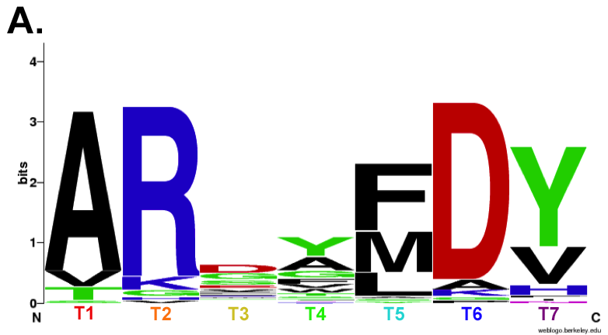
Bulged torso structures share similar sequences
D
Y
F
R
D
A
Y

Slide 20
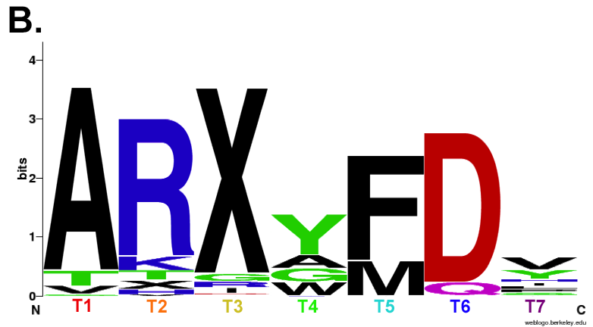
The bulged torso sequence motif is germline encoded
Bulged Consensus
Germline Consensus
Notes:
----- Meeting Notes (6/29/15 14:02) -----
This is *why* bulged are more prevalent

Slide 21
HCDR3 torso domain conformations
Bulged
Non-bulged or
extended

Slide 22
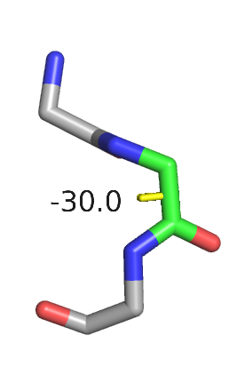
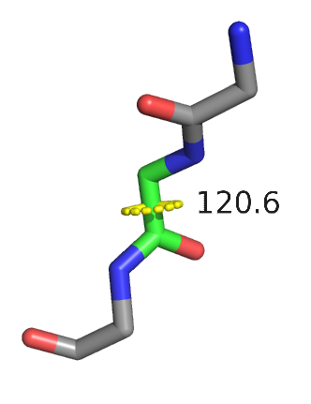
Protein backbone structure
R
Φ (phi)
O
R
Cα
N
Ψ (psi)
OH
C
Cα
N
C
Cα
N
C
O
R
O
Non-bulged or
extended
Bulged

Slide 23
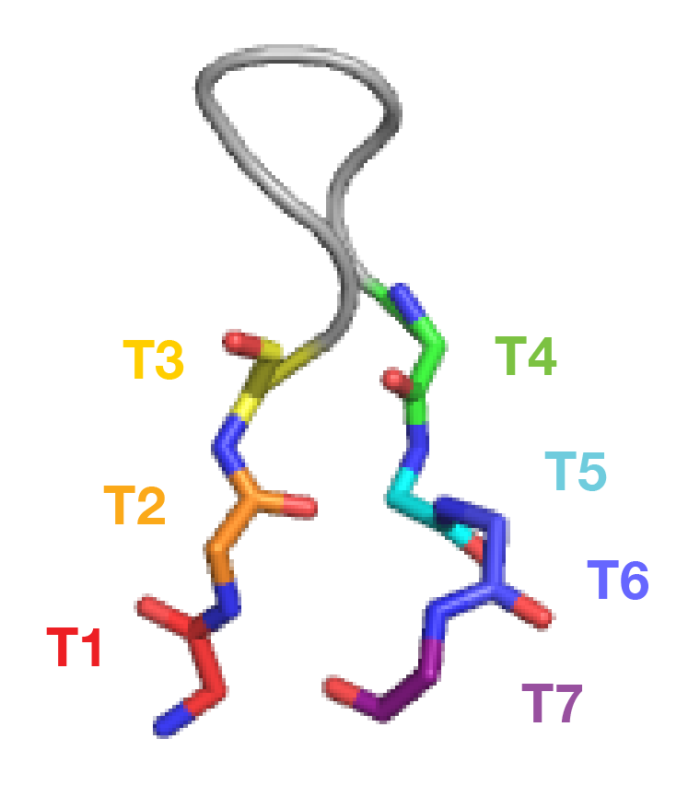
Bulged and non-bulged dihedral angle measurements differ
Notes:
Rosetta can use these values as restraints

Slide 24
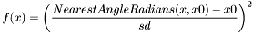
Rosetta uses knowledge-based restraints to restrict modeling
Rosetta constraint files apply a score penalty to models that break defined rules
Dihedral C 95 N 96 CA 96 C 96 CIRCULARHARMONIC -2.5 0.2
Dihedral C 96 N 97 CA 97 C 97 CIRCULARHARMONIC -1.7 0.3
Dihedral C 97 N 98 CA 98 C 98 CIRCULARHARMONIC -1.8 0.6
Dihedral C 121 N 122 CA 122 C 122 CIRCULARHARMONIC -2.0 0.8
Dihedral C 122 N 123 CA 123 C 123 CIRCULARHARMONIC -1.7 0.5
Dihedral C 123 N 124 CA 124 C 124 CIRCULARHARMONIC -1.5 0.3
Dihedral C 124 N 125 CA 125 C 125 CIRCULARHARMONIC -2.3 0.4
Dihedral N 96 CA 96 C 96 N 97 CIRCULARHARMONIC 2.6 0.2
Dihedral N 97 CA 97 C 97 N 98 CIRCULARHARMONIC 2.5 0.2
Dihedral N 98 CA 98 C 98 N 99 CIRCULARHARMONIC 2.4 0.5
Dihedral N 122 CA 122 C 122 N 123 CIRCULARHARMONIC 2.8 0.5
Dihedral N 123 CA 123 C 123 N 124 CIRCULARHARMONIC 1.8 0.3
Dihedral N 124 CA 124 C 124 N 125 CIRCULARHARMONIC -0.6 0.5
Dihedral N 125 CA 125 C 125 N 126 CIRCULARHARMONIC 2.3 0.3

Slide 25
Additional loop building options needed to apply restraints
-score:weights talaris2014.wts
-score:patch dihedral_cst.wts_patch #Patch to turn on dihedral term
-constraints:cst_file 4m5y_bulged.constraints #Your restraints file
-constraints:cst_weight 1 #Weight all of the constraints by 1
-constraints:viol
-constraints:viol_level 101

Slide 26
Analyzing your results

Slide 27
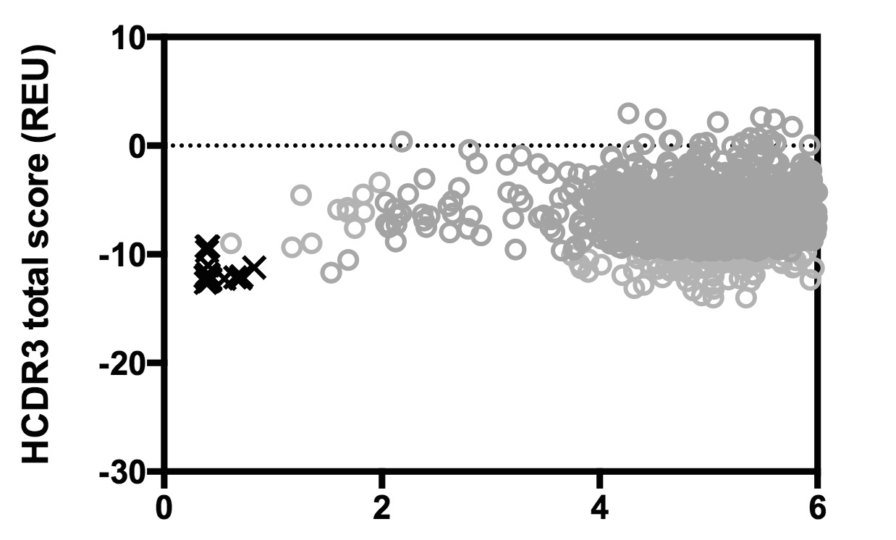
Analyzing Rosetta HCDR3 modeling results: score vs. rmsd
Native
structure
Models
Cα RMSD (Å)

Slide 28
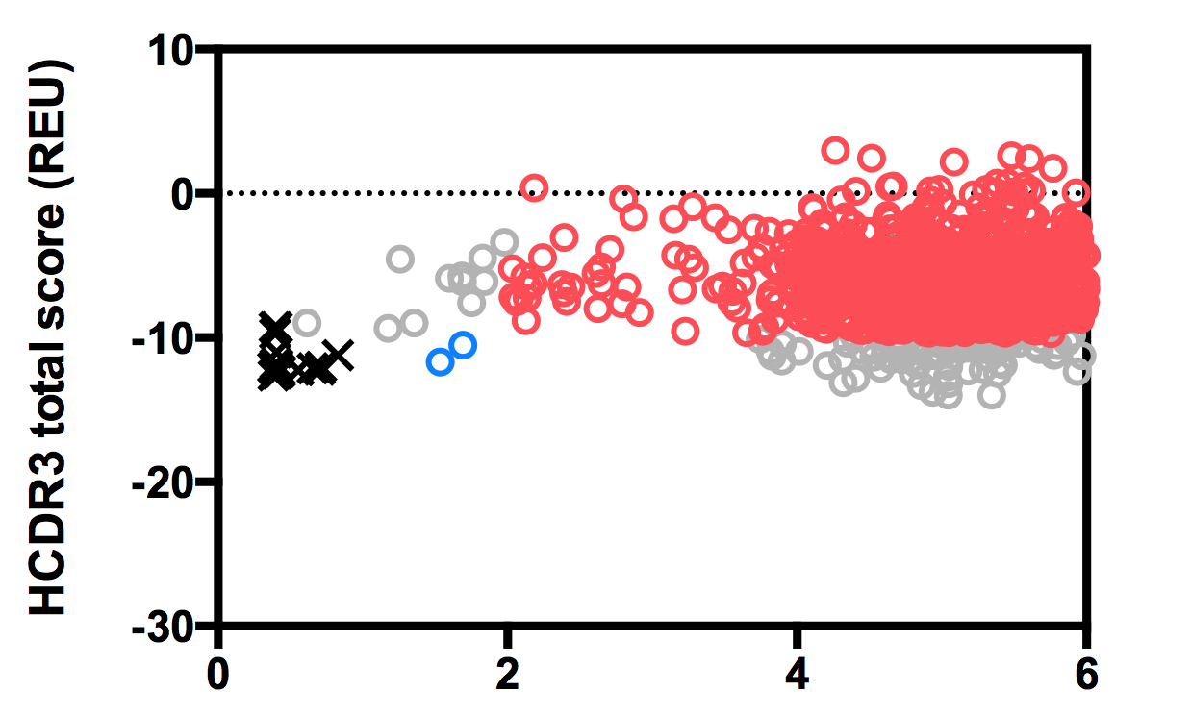
Analyzing Rosetta HCDR3 modeling results: score vs. rmsd
False
Negatives
True
Negatives
True
Positives
False
Positives
Cα RMSD (Å)

Slide 29
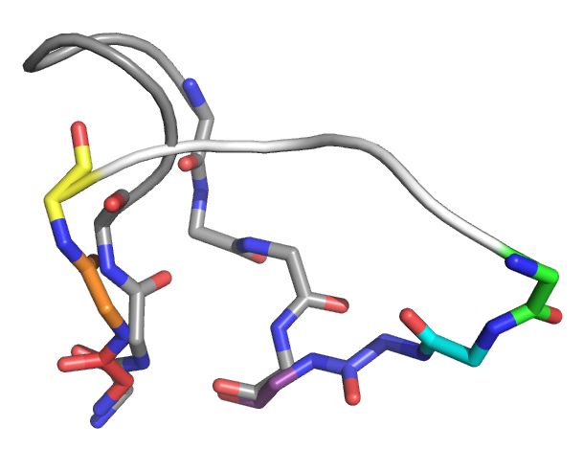
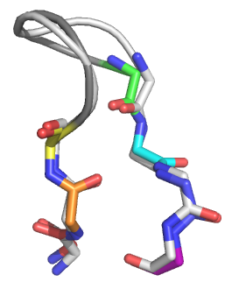
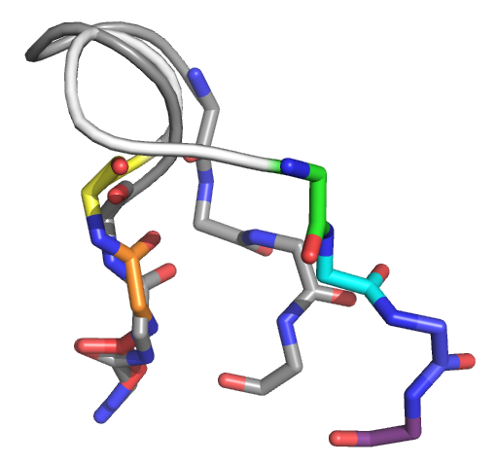
Analyzing Rosetta HCDR3 modeling results: visualize it!
Cα RMSD (Å)

Slide 30
References
A new clustering of antibody CDR loop conformations. North B, Lehmann A, Dunbrack RL. J Mol Biol. 2011.
Improving loop modeling of the antibody complementarity-determining region 3 using knowledge-based restraints. Finn JA, Koehler Leman J, Willis JR, Cisneros A III, Crowe JE Jr., Meiler J. PLOS ONE. 2016.
Accurate structure prediction of CDR H3 loops enabled by a novel structure-based C-terminal constraint. Weitzner BD, Gray JJ. J Immuno. 2017.

Slide 31
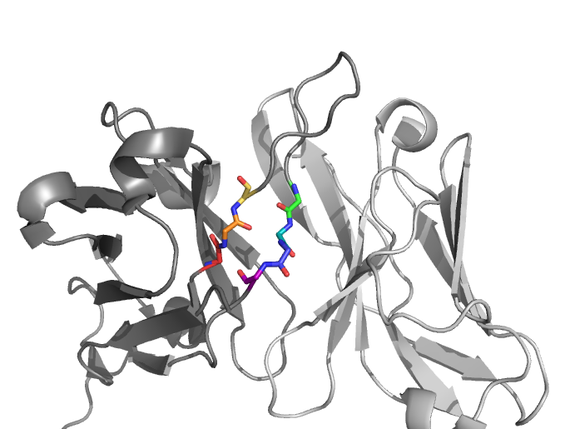
Today’s tutorial
Antibody: 5J8 PDB ID: 4M5Y
HCDR3 length: 17 HCDR3 torso: Bulged

